Slide 1
1. Introduction to ‘C’ language
History of C
Features of C
Uses of C
Structure of C Program
Keyword, Identifiers & Constants

Slide 2
History of C
The C is a SOP language, developed at Bell Laboratories in 1972 by Dennis Ritchie
C features were derived from an earlier language called “B” (Basic Combined Programming Language – BCPL)
C89/C90 standard – First standardized specification for C language was developed by the American National Standards Institute in 1989.
C99 standard – Next revision was published in 1999 that introduced new features like advanced data types and other changes.

Slide 3
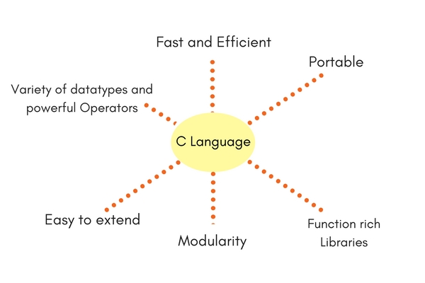
Features of C

Slide 4
Uses Of C
Database systems
Graphics packages
Word processors
Spreadsheets
Operating system development
Compilers and Assemblers
Network drivers
Interpreters

Slide 6



